Slide 1
UDI HDK Roadmap
http://www.sco.com/forum1999/conference/developfast/f7
Matt Kaufman
Senior Software Engineer
E-mail: mek@sco.com
Notes:
This is the second in a series of eight UDI presentations for SCO Forum 1999.
This session explains how and when UDI development kits will be made available, and how they will ultimately be merged into the SCO HDK and Base OS. It also describes plans for test suites, sample drivers, and debugging tools.

Slide 2
UDI HDK Roadmap - Why UDI?
UDI lets you write once, port for free
UDI Version 1.0 is at the editors. See http://www.sco.com/udi/specs.html
UDI will be supported on all SCO O/S’s
  UnixWare 7, Release 7.1 and 7.2
  OpenServer runtime (Mid-2000)
  Monterey 64

Slide 3
UDI HDK Roadmap - UDI Timetable
UDI alpha DK available today at http://www.sco.com/UDI/sco/udidk
UDI DK and runtime PTF for UnixWare 7, Release 7.1 in Q4 1999
Native UDI DK, doc, runtime for UnixWare 7, Release 7.2 in ‘00

Slide 4
UDI HDK Roadmap - UDI Timetable
Going forward, UDI will be on Monterey but DDI will not
Download the UDI spec today; go to the talks
UDI - your path to Monterey 64

Slide 5
UDI HDK Roadmap - UW 7.1
Alpha version of the UDI Developer kit for UnixWare 7 Release 7.1 available today
Downloadable from http://www.sco.com/UDI/sco/udidk
UDI version 1.0rc3 compliant

Slide 6
UDI Alpha DK info (cont’d)
Alpha DK includes tools to
  compile your driver (udibuild)
  create UDI-compliant driver package (udimkpkg)
  install a UDI-compliant driver package on UW (udisetup)
pkgaddable atop UW 7.1

Slide 7
UDI Alpha DK info (cont’d)
Alpha DK supports UDI specs, including
  Core Services
  Physical I/O
  SCSI Driver
  Network Driver
  PCI Bus Binding

Slide 8
UDI Alpha DK (cont’d)
Alpha DK includes sample drivers
  DPT SCSI (see F12: UDI SCSI Drivers)
  CMOS
Alpha DK includes tools to
  compile driver (udibuild)
  build driver package (udimkpkg)
  install package on UW system (udisetup)

Slide 9
UDI Alpha DK info (cont’d)
Alpha DK to be updated monthly, see release notes for restrictions
E-mail address (udidk@sco.com) for feedback
Plan to ship as official PTF Q4 1999
  includes tuning, doc, full 1.0 support
  will form basis for UnixWare 7 Release 7.2 implementation

Slide 10
UDI HDK Roadmap - UW7.2
UDI will be the native driver model for UnixWare 7 Release 7.2
Still will support drivers written to DDI version 6 or higher
Full support (HDK, samples, tools, debugging)

Slide 11

Project Monterey
Project
Product Line
Power IA-32 IA-64
Monterey
AIX®
SCO
Technology
IBM
Technology
Sequent
Technology
UnixWare®
Available at Initial Merced Release
Notes:
Project Monterey is a joint project of SCO, IBM, and Intel.
End result is a common “family” of server platforms:
UnixWare 7 on IA-32
AIX on PowerPC
Monterey-64 on IA-64
Monterey-64 is a merging of UnixWare 7 & AIX technologies, with contributions from Sequent & other OEMs as well as new 64-bit specific enhancements.
Targeted to be available at the initial release of the Merced processor:
2nd half 2000

Slide 12
UDI Support in Project Monterey
UDI critical to Project Monterey success
  Single driver model for all 3 platforms
UDI is preferred driver model for Monterey-64 on IA-64
  Available in the first release

Slide 13
Monterey UDI SDK Schedule
UDI SDK first release in mid-2000
  Monterey-64 on IA-64
  AIX® on PowerPC
UnixWare® 7 is obvious development platform of choice for now
  Simply recompile for IA-64 or PowerPC

Slide 14
Adaptec UDI Roadmap
http://www.sco.com/forum1999/conference/developfast/f7
Mark Bradley
Adaptec
Project UDI Advisor
E-mail: markb@btc.adaptec.com

Slide 15
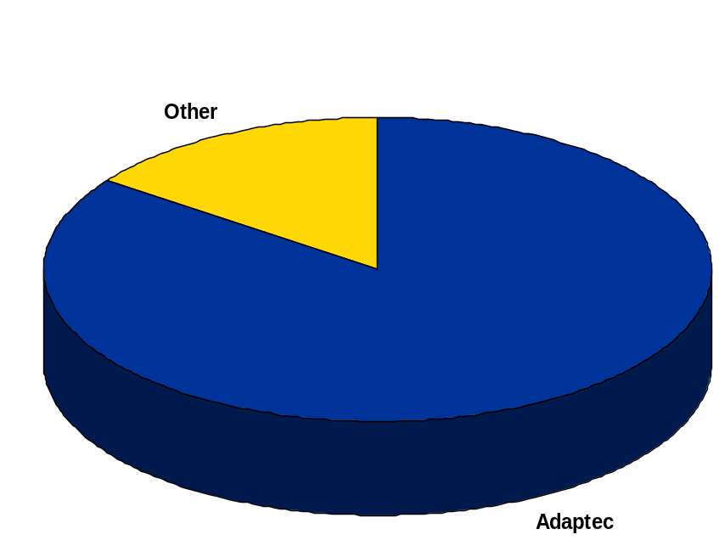

Adaptec Market Share in the
SCSI I/O marketplace
Adaptec owns the SCSI I/O marketplace due to:
  Superior compatibility, Outstanding reliability,
  Professional support, and…….

Slide 16
Adaptec Supports UDI
Early involvement w/ Project UDI
UDI Driver for Prototyping of spec.
Drivers for U160 products
  Announcements to OEM’s has been done
  Public Announcement of availability ‘00

Slide 17
Adaptec Supports UDI
UDI is in line with our value-add proposition of solid drivers for our customers
Allows Adaptec to hit several OS’s with one driver source
Unlike other standards, allows continued value to be in silicon, and….

Slide 18

Leading with New SCSI Technology
Speed
160 MB/second
doubles the transfer rate of Ultra2 SCSI
SCSI
Backward compatibility protects your investment with the same SCSI your business runs on today
Manageability
Domain Validation intelligently tests the storage networkCRC enables higher reliability

Slide 19
Introduction to UDI
Intel’s Network Interface Division Roadmap
John A. Ronciak
Staff Software Engineer
Intel Corporation
E-mail: john.ronciak@intel.com
Notes:
This is the SCO Forum 1999 presentation template.
Please use this presentation (strikeover) to create yours instead of “applying the style” of this presentation to a pre-existing or new one. This is so handouts will retain the style of the ones in this presentation. Note: PowerPoint doesn’t have the capability of “applying the style” to handouts other than presenter’s notes.

Slide 20
Intel’s NID Roadmap
Why UDI?
Intel’s plans
  When and where to expect UDI nic drivers
Expectation of UDI
  Performance, extensibility and OS neutrality
®

Slide 21
Why UDI?
Our division acts as an IHV for Intel’s network adapters
  Problems that UDI attempts to solve for an IHV
    Multiple OSs supported with one driver
    Multiple adapter drivers derived from a single driver
      only hardware specific source code changes
®
Notes:
An optional second logo can be placed in lower left-hand corner of slide. If the logo is to be used on EVERY slide, put it on the master slide.

Slide 22
Why UDI? (cont.)
  Results from using UDI
    Testing effort for the multiple OSs becomes much easier
    Brings the industry together by offering a standard way in which to write device drivers making it easier for the industry to get more devices supported
    Makes the migration from IA-32 to IA-64 easy
      The same driver will work on both architectures with a re-compile
®

Slide 23
Intel’s plans
Have been working on our driver design since the 0.90 version of the specification was produced
  We’ve moved onto the 1.0 version to finish the design
  Driver design almost finished today
Will be ready for the early beta’s of Monterey
  AIX version of our current DDI 8 driver for power-on
Will be fully supported through the IA-64 launch
Intel’s PRO/100+ and the PRO/1000 series nics will be supported at the IA-64 launch
®
Notes:
A subtitle can be added to the title of a slide. Carriage return after title and type in text of subtitle after title. Highlight subtitle text and reduce type size and remove BOLD style. It should be in regular (NOT BOLD), size 24 type.

Slide 24
Expectation of UDI
Better performance
  Better network performance
  Fewer CPU cycles used to produce the same network load
  Better reliability and stability
Fewer versions of nic drivers to support
  Development costs as well as the support and testing efforts are reduced with fewer driver versions
Get our driver onto more OSs than it currently is ported to since the driver is OS neutral
®
Notes:
The machine icons shown here were drawn from an aerial-view perspective. Whenever possible, please try to keep your diagramming similar to that shown here to keep the perspective/style consistent.

Slide 25
Presenter’s Notes Cover Page
Go to “Notes Page View” to see this one
Put this page at end of presentation so numbering of slides will remain accurate.
Notes:
Presenter’s Notes
F7: UDI HDK Roadmap
August 19, 1999

